Slide 1
Vehicle Blind Spot Assist System
Tanzim Mokammel
Valikhan Kuparov
Hani Hadidi

Slide 2
Motivation
Introduce an universal system that can potentially be used on real cars to reduce accidents related to lane changing
Experiment with vehicle automation features in order to contribute to advancing accident prevention technologies

Slide 3
Project Goal
Design a system that will detect obstacles present or approaching a remote-controlled vehicle’s blind spot
Attain control of the remote-controlled vehicle to prevent user’s from steering into an obstacle

Slide 4
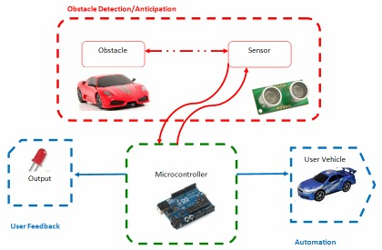
System Level Overview

Slide 5
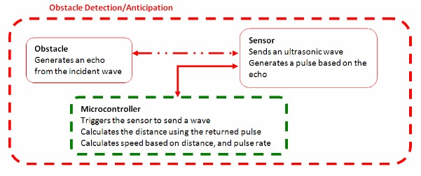
Module Level Descriptions – Obstacle Detection/Anticipation

Slide 6
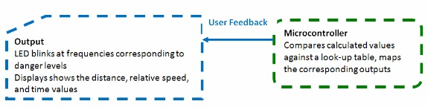
Module Level Descriptions – User Feedback

Slide 7
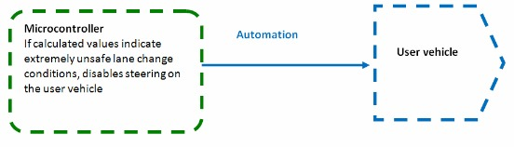
Module Level Descriptions – Automation

Slide 8
Alternatives
Input
Output
Controller
Automation

Slide 9
Alternatives - Input
Input - Obstacle Detection | SRF05 Ultrasonic Rangefinder | Good range (~ 3m) and accuracy (± 2% error), relatively cheap ($40) | Complex programming required; relatively expensive; prone to interference from miscellaneous obstacles
 | LR3 - Precision USB Laser Rangefinder | Very high accuracy (±3mm) and range (30m) | Expensive ($150); requires external tools, very sensitive to light conditions
 | Sharp IR Rangefinder R48-IR12 | Very cheap ($15); immune to ambient light interference; low power consumption | Narrow beam width; prone to other IR sensor interference, low range (10 cm - 80 cm)
 | Camera - image detection | Accurate; images can be reproduced for the driver | Complex image processing algorithms required; expensive

Slide 10
Alternatives - Output
Output - Feedback | Visual | Very informative; aesthetically pleasing | Distracting; expensive; may experience scaling issues, resulting in inaccurate and unreliable output
 | Numerical | Quantitative; very accurate; informative | May cause confusion among some users; aesthetically displeasing
 | Simple - blinking light | Inexpensive; Easy to implement; very simple, yet informative | No quantitative feedback; small in size
 | Auditory - Beeping sounds | Easy to implement; Inexpensive; simple | Irritating; may be inaudible due to music or ambient sounds
 | Physical - Vibration of the steering wheel | Very effective | Distracting; vehicle dependent

Slide 11
Alternatives - Microcontroller
Component | Possible solution | Advantages | Disadvantages
Micro-Controller | Arduino Uno | Programmed using C/C++; cheap ($30); Easy to use due to its IO pins | Relatively bigger in size than other controllers
 | Picaxe | Comes with software that allows flow charts; No programming required; Easy to work with | Limited functionality

Slide 12
Alternatives - Automation
Automation | Automated Lane Merging System | Allows the user to easily and safely change lanes | The automated lane change system may cause the undesirable vehicle speeds; the automated system may not be able to change lanes fast enough for certain cases such as exiting the freeway; impractical during high traffic
 | Steering-Lock | Prevents collisions during lane changes | Takes away the user’s judgment factor; may cause a more serious frontal collision

Slide 13
Validation Tests
Requirements |  | Test | Acceptance Criteria
Obstacle detection/anticipation | Sensors should measure distances accurately | Place obstacles at 4 different distances(3cm, 1m, 2m, 3m) away from the sensors | Computed distances match the measured distances within ±2.5% error
 | Blind spot Coverage | Mount the sensors on the remote controlled (RC) car to cover the defined blind spot (Appendix F); place obstacles within it | The sensors detect the presence of the obstacle within the defined range
 | Microcontroller should compute relative speed based on distance values | Mount sensors to the RC car; place an obstacle and the RC car in motion with a known relative speed | The microcontroller’s calculated speed values match the known value within ±5% error
 | Obstacle Anticipation | Set up situations where both distance and relative speeds are known, and perform allowed time calculations with the microcontroller | The microcontroller’s time values match the calculated ones within ±12% error
Output | The Light Emitting Diodes (LED) and the display should provide accurate feedback to the user | Observe the feedback response of the LED and the Liquid Crystal Display (LCD) display | The LED should behave according to the defined look-up table (Appendix H); the display should contain calculated values of distance to obstacle; relative speed, and time left for a lane change
Auto- Mation | The steering of the RC car should lock when necessary | Simulate the extremely dangerous, and very unsafe cases (Appendix H) | The steering of the user car is irresponsive in the direction of the obstacle

Slide 14
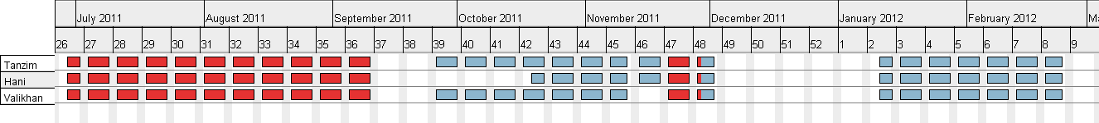
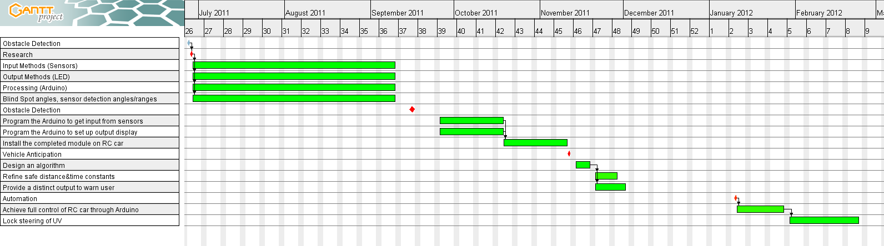
Gantt Chart

Slide 15
Deliverables for December Review
Distance/Speed Calculations
LED/LCD Display Implementations
Integration of Sensors with Output
Control of a RC Car

Slide 16
Overall Technical Roles
Tanzim
Sensor Programming (acquiring distance, and relative speed)
Valikhan
Output Module Programming (LED, Display), and integration with sensors
Hani
Control of RC Vehicle through the microcontroller

